Slide 1
CHAPTER 6
Managing Customer Relationships

Slide 2
Chapter Objectives
Explain relationship marketing, its goals, and the benefits of long-term relationships for firms and customers.
Explain why and how to estimate customer relationship value.
Introduce the concept of customer profitability segments as a strategy for focusing relationship marketing efforts.
Present relationship development strategies.
Identify challenges in relationship management, including the idea that “the customer is NOT always right”.

Slide 3

Relationship Marketing
Shifting focus from transaction to relationship.
The philosophy of doing business that focuses on initiating, keeping, and improving relationships with current customers rather than acquiring new customers.
Important factors:
  Brand loyalty
  Location /Accessibility
  Consistency

Slide 4
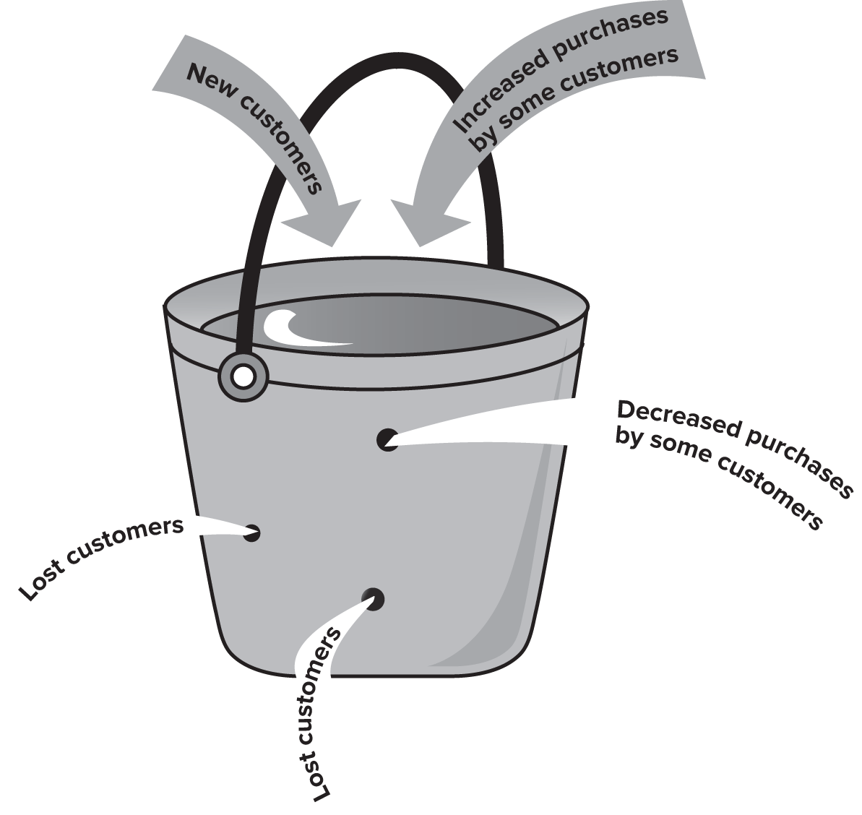
Bucket Theory of Marketing
Holes in the Bucket: Why Relationship Development Makes Sense
You focus on always filling the bucket – pushing customers into your bucket.
But if you have holes, then customers leak out.
Depending on how big the weaknesses in your business are, determines how small/big these holes are.
If you focus on relationship, then you can keep customers from leaking out – even if there are holes (customer loyalty).

Slide 5
The Evolution of Customer Relationships
Strangers
Acquaintances
Friends
Partners

Slide 6
The Evolution of Customer Relationships
Strangers: potential customers who have not yet had any transactions (interactions) with a firm and may not even be aware of the firm. The goal here is to attract and acquire.
Acquaintances: Once customers are aware, familiarity is established, and the customer is now an acquaintance. Primary goal at this stage is satisfying the customer (or potential customer).
Notes:
When acquaintances, repetitive interactions improve firms’ knowledge of customers – facilitates transactions through reduction of customer’s perceived risk and the provider’s costs.

Slide 7
The Evolution of Customer Relationships
Friends: Customers now makes purchases, and the firm starts to receive value in exchange – collecting knowledge of the customer needs. The focus in this stage is building trust with the customer, and customer retention.
Partners: a loyal customer, who trusts the firm, likely to recommend the business to friends and family, and is committed. The focus in this stage (so the customer does not look for alternatives) is enhancing the relationship.
Notes:
Partners: bank checking account customer becomes a better customer as she sets up a savings account, takes out a loan, and/ or uses the financial advising services of the bank.

Slide 8
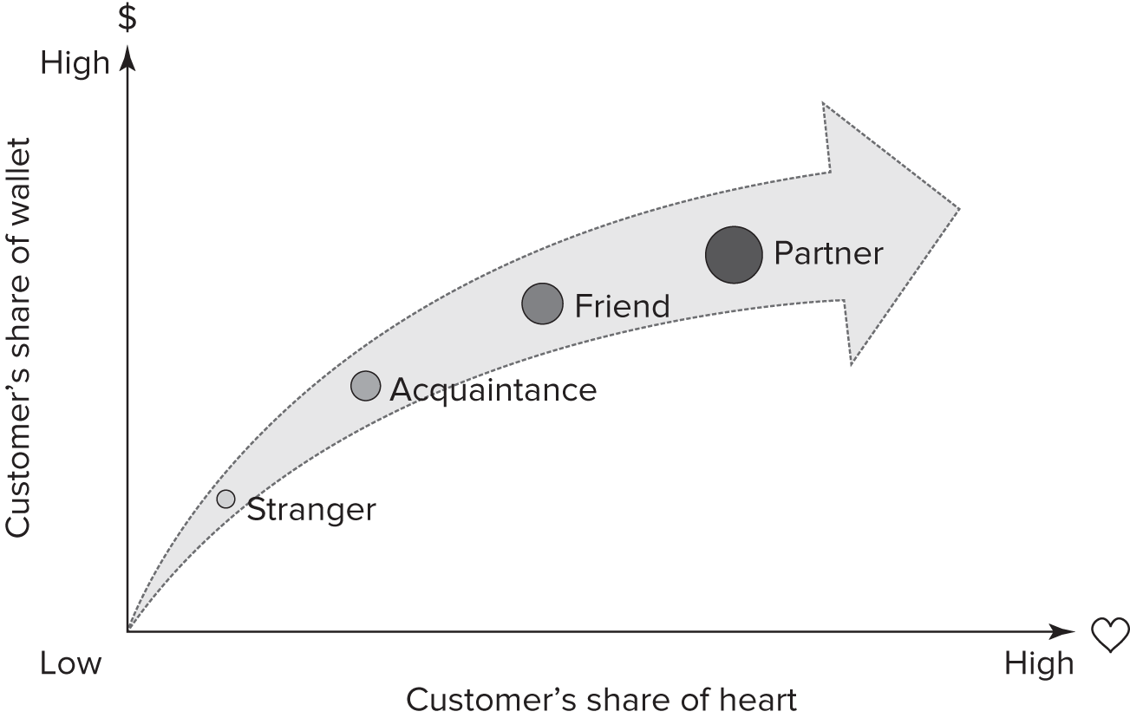
The Goal of Relationship Marketing
Share of Wallet vs. Share of Heart
Notes:
To build and maintain a base of committed customers who are profitable for the firm.
Share of wallet: percentage of a person’s total amount spent dedicated to a particular company rather than competing companies.
Share of heart: strength of the emotional bond that customers form with the company.

Slide 9
Customer Lifetime Value/ Profitability
Customers are more valuable the longer they are loyal
  Less costs/ no costs to acquire them
  Less costs/ no costs to sell to them
  They promote your business through WOM
Using this model – you can calculate how much valuable a customer will be over a period of time:
CLV = customer value x average customer lifespan

Slide 10
Example: Travel Agency
A travel agency has an average sale of $2000. the typical customer uses the service two times a year, over an average of seven years.
Revenue = $2000 (average sale) X 2 (annual visits) X 7 (years) = $28,000

Slide 11
Example: Travel Agency
 | Year 0 | Year 1 | Year 2 | Year 3 | Year 4 | Year 5
Revenue:
Business Package | — | $30,000 | $38,000 | $48,500 | $62,500 | $80,000
Vacation Package | — | $5,500 | $8,000 | $11,500 | $17,250 | $25,000
Costs:
Business Package | $5,000 | $23,000 | $28,000 | $35,000 | $43,500 | $53,500
Vacation Package | — | $3,500 | $4,000 | $5,000 | $6,800 | $9,000
Lifetime Customer Value Calculation
Business Package Profit | ($5,000) | $7,000 | $10,000 | $13,500 | $19,000 | $26,500
Vacation Package Profit | — | $2,000 | $4,000 | $6,500 | $10,450 | $16,000
Reduced Overhead Allocation | — | $500 | $800 | $1,200 | $1,800 | $2,500
Profit from Referrals | — | $1,000 | $2,000 | $4,000 | $6,000 | $10,000
CLV | ($5,000) | $10,500 | $16,800 | $25,200 | $37,250 | $55,000

Slide 12
CLV Calculations
A subscription service charges $20 per month per customer. The average customer stays subscribed for 10 months. What is the lifetime value (CLV) of a customer?
Revenue = $20 (average sale) X 10(months) = $200

Slide 13
CLV Calculations
A retailer has an average order value (AOV) of $50, and customers make 4 purchases per year. The average customer lifespan is 3 years. The profit margin on each order is 30%. Calculate the CLV.
Revenue = $50 (average sale) X 4 (annual purchase) X 3 (years) X 0.3 (profit margin) = $180

Slide 14
CLV Calculations
Segment A customers have an AOV of $100, purchase 3 times per year, and stay for 2 years. Segment B customers have an AOV of $80, purchase 4 times per year, and stay for 3 years. Which segment has a higher CLV if the profit margin is 25%?
Segment A Revenue = $100 (average sale) X 3 (annual purchase) X 2 (years) = $600
Segment B Revenue = $80 (average sale) X 4 (annual purchase) X 3 (years) = $960

Slide 15
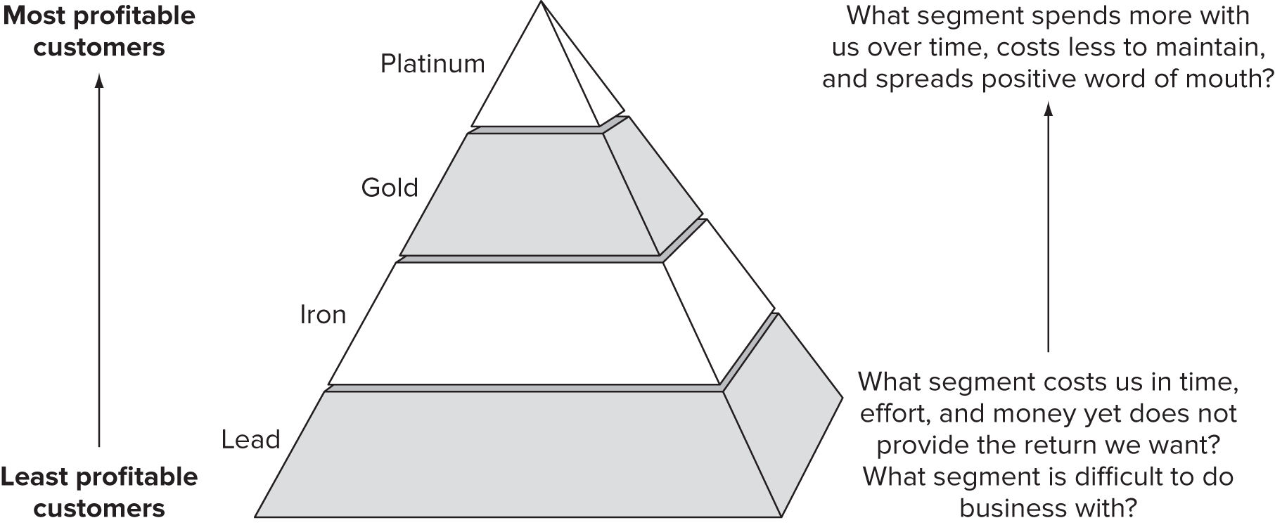
Profitability Tiers – The Customer Pyramid
Notes:
Platinum: most profitable customers, willing to invest and try new offerings, and are committed to the firm.
Gold: Not as loyal, might ask for discounts, but also might be heavy users.
Iron: essential customers who provide the volume needed to sustain the business but lower spending levels so not enough for special treatment.
Lead: costing the business money. They demand more attention than they are due based on how much they spend.

Slide 16


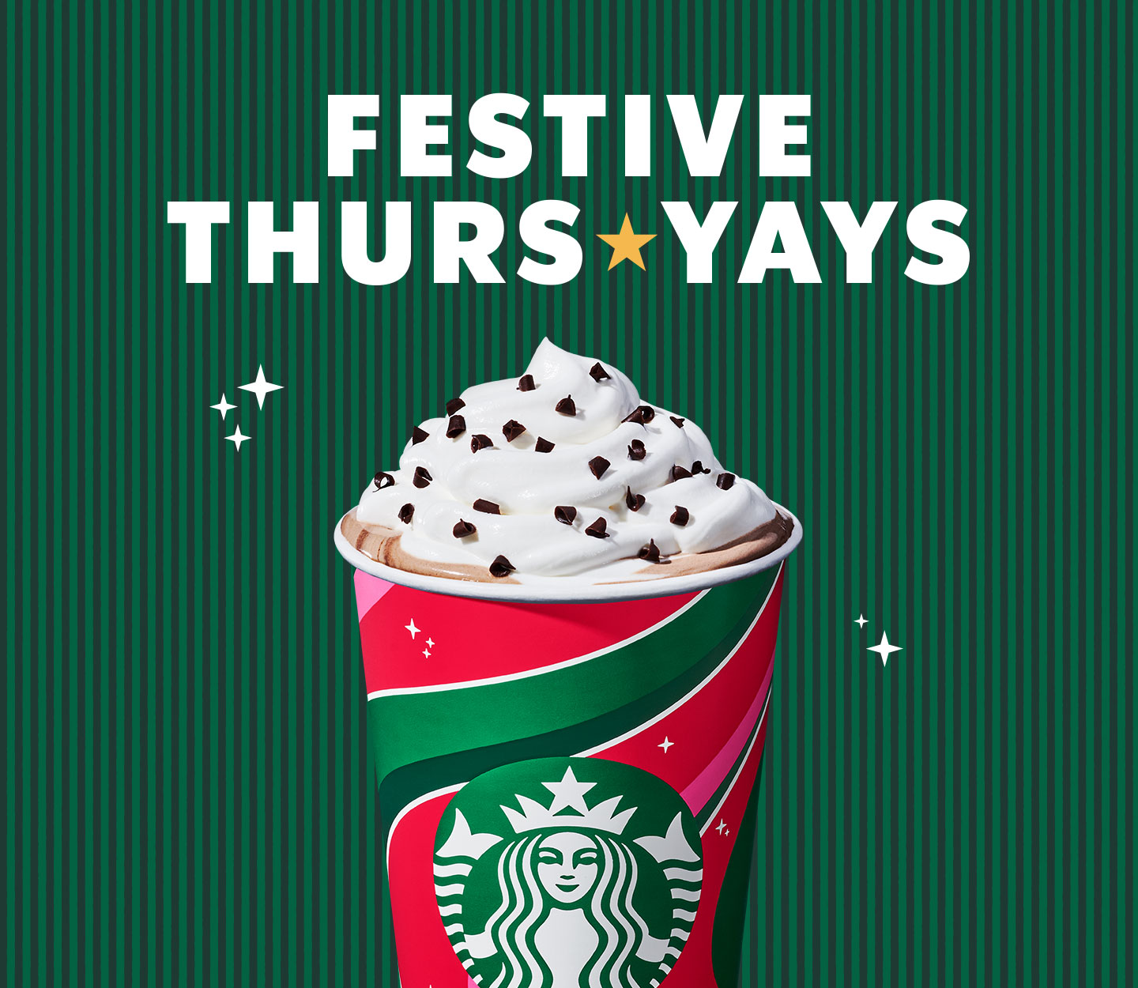
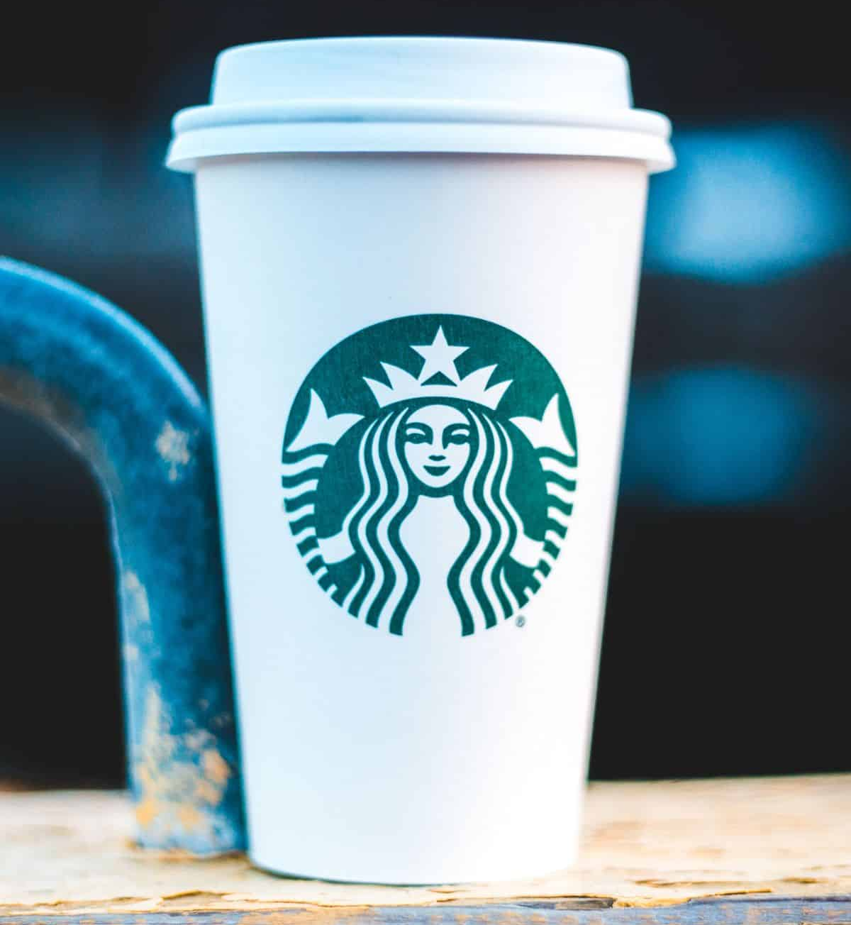
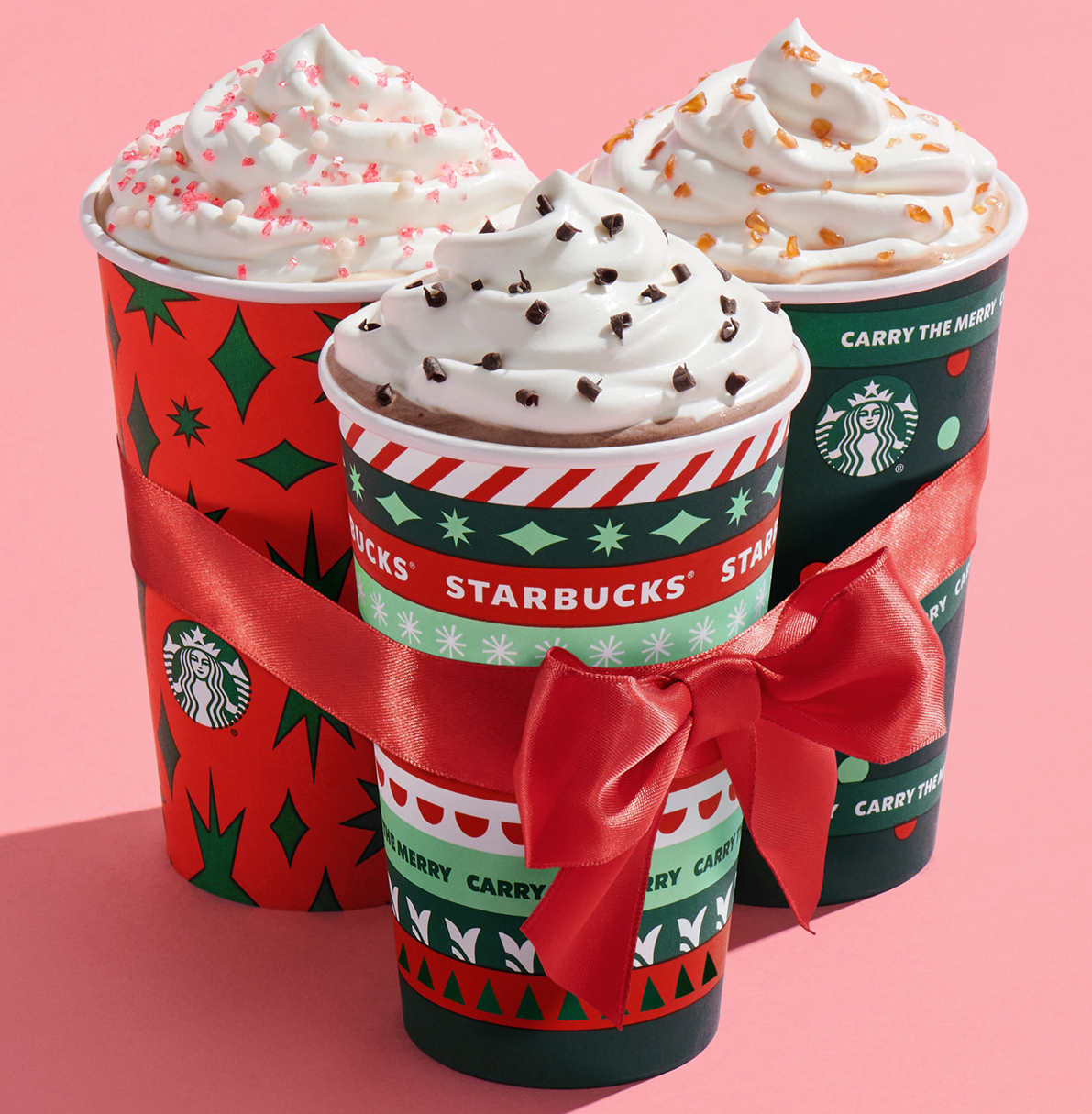
Profitability Tiers – The Customer Pyramid
Notes:
Platinum: buys specialty, expensive drinks
Gold: App users, buy a lot but also retain a lot discounts/ offers
Iron: drink only regular coffee, no handcrafted/ specialty beverages
Lead: only buy if there is an offer available

Slide 17
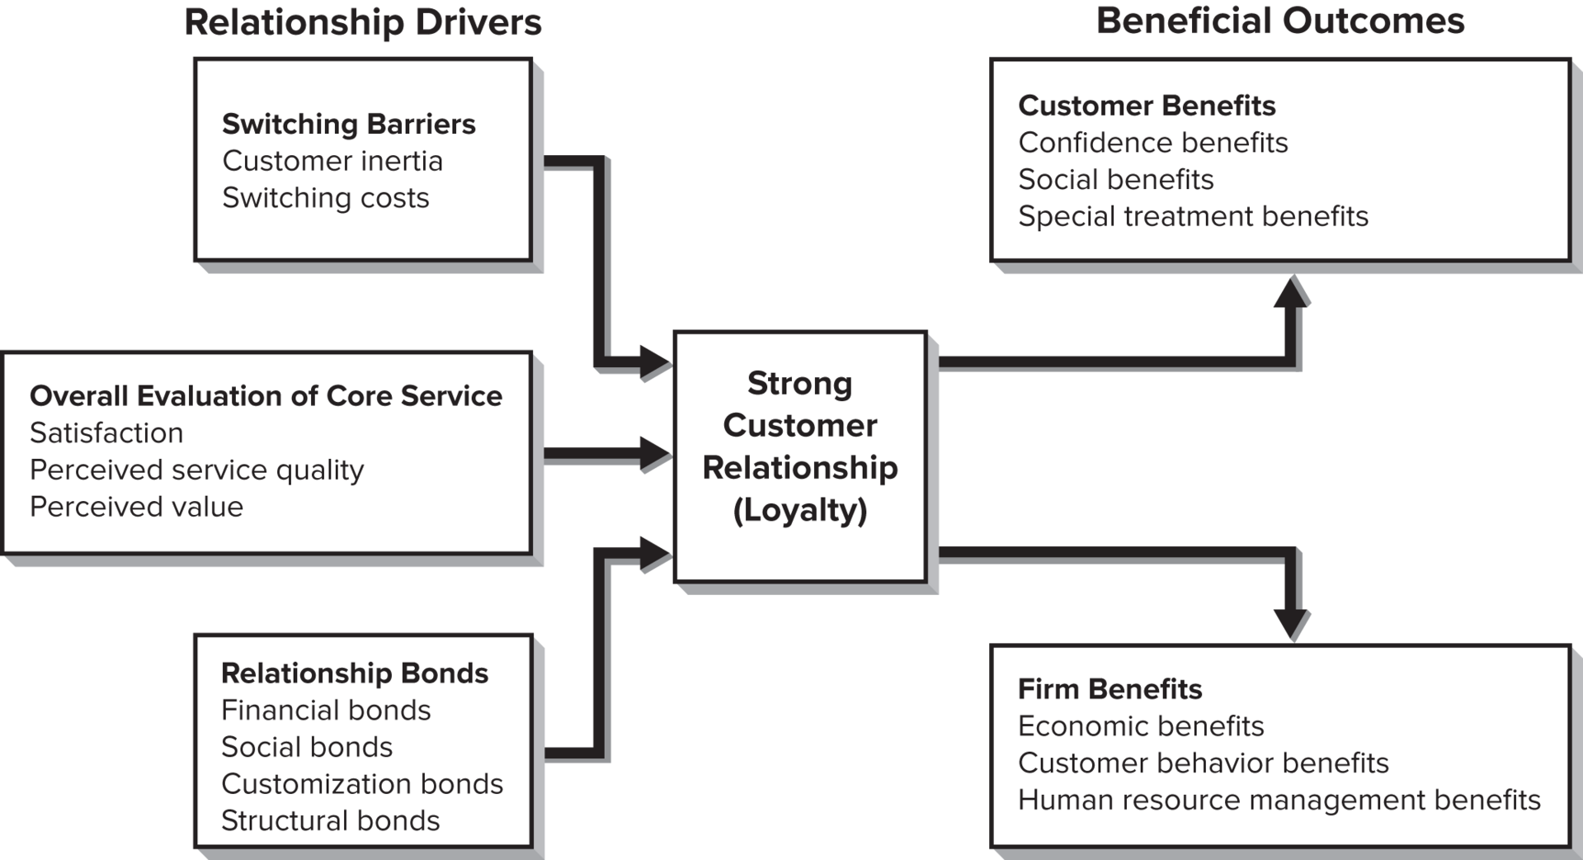
Relationship Development Model

Slide 18
Relationship Drivers
Overall Evaluation of the Core Service – most important factor
Switching Barriers – factors making it difficult for customers to switch to new service providers
Relationship Bonds – activities so that customers want to be loyal to the firm
  Types of bonds: Financial, Social, Customization, Structural

Slide 19
Benefits of Customer Retention
Benefits for Customers
Confidence Benefits
Social Benefits
Special Treatment Benefits
Benefits for Firms
Economic Benefits
Customer Behavior Benefits
Human Resource Management Benefits
Notes:
Confidence: feelings of trust or confidence in the provider along with a sense of reduced anxiety – frees up time for other concerns and priorities of the customers.
Social: customers develop a sense of familiarity and even social relationship with their service providers – flip side is the risk of losing customers when an employee leaves.
Special Treatment: being given a special deal or price, getting preferential treatment, or perhaps receiving the “benefit of the doubt” from the service provider.
Economic: increased purchases over time – highly satisfied customers are willing to pay more for a provider’s services, lower costs.
Customer Behavior: free advertising through word-of-mouth communication.
Human Resource Management: customers may help coproduction by assisting in service delivery.

Slide 20
The Customer is NOT Always Right
The wrong segment (e.g., offering a daytime MBA program to people who work full-time).
Not profitable in the long term (e.g., a customer who has bad credit so is less likely to make payments on time even if they qualify for the service).
Difficult customers (e.g., dysfunctional customers who intentionally disrupts otherwise functional service encounters).

Slide 21
Should Firms Fire Their Customers?

Slide 22
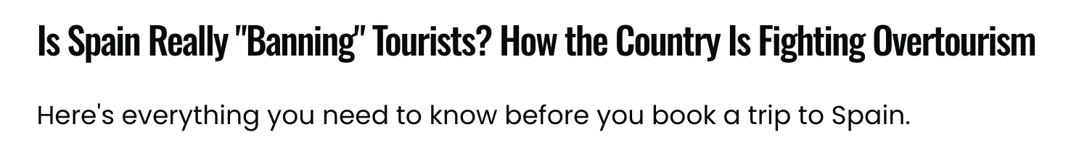

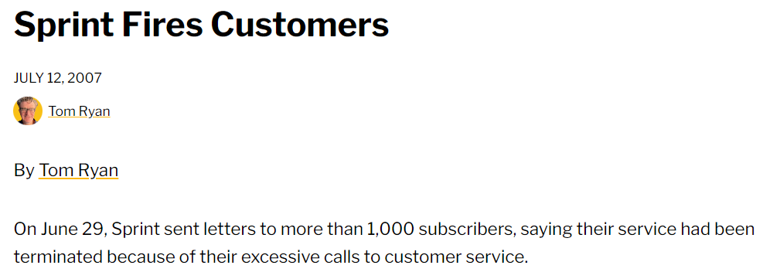
Discussion
Notes:
Spain banning tourism

